Slide 1
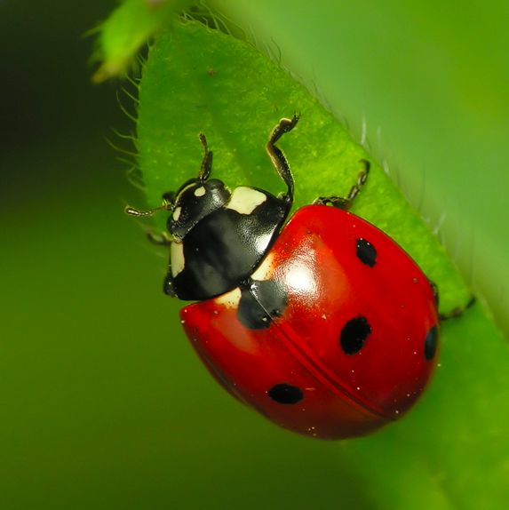
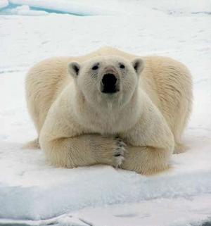
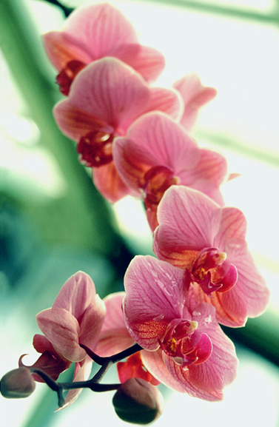
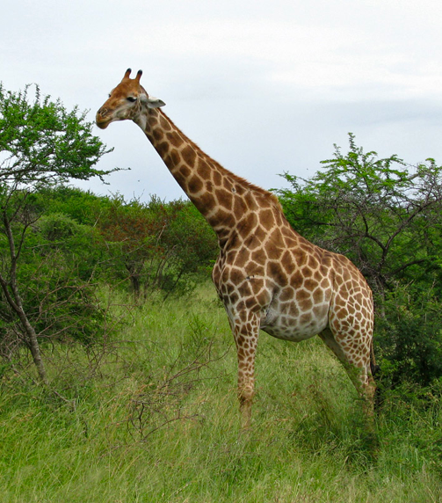
Classifying living things
Creating dichotomous keys and trees

Slide 2
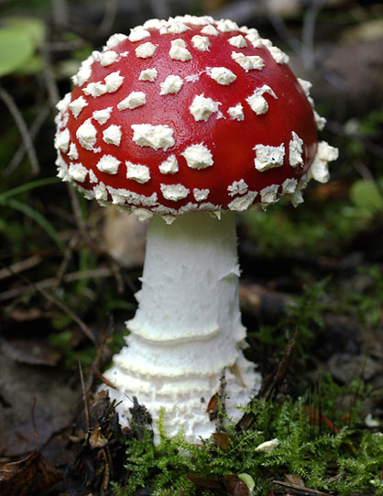
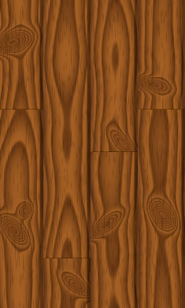
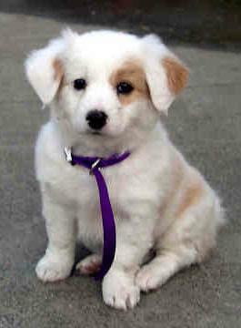
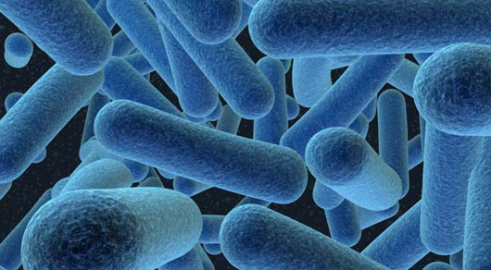
Review – what is life?
What do we mean when we say something is “alive”?
Made up of cells
Takes in energy to grow and reproduce
Responds to the environment

Slide 3
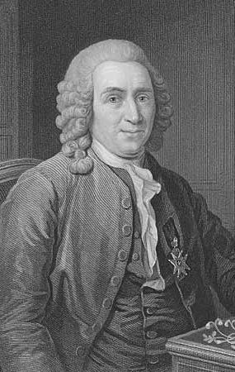
Grouping living things
Scientist who organized how we group living things
Groups based on shared characteristics
Hierarchy
Binomial nomenclature
Genus species
Carl Linnaeus
1707-1778

Slide 4
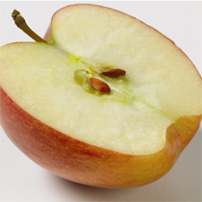
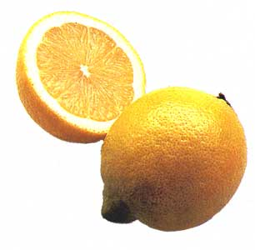
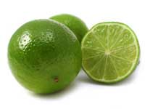
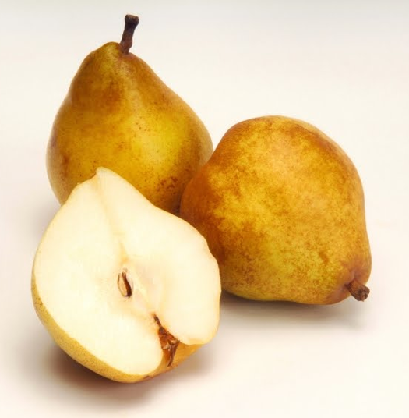
Classification by characteristics: dichotomous key
1a. Does it have thick skin? (go to 2)
1b. Does it have thin skin? (go to 3)
2a. Is it green? LIME
2b. Is it yellow? LEMON
3a. Is it round? APPLE
3b. Is it not round? PEAR

Slide 5
Classification by characteristics: tree
not round
green
yellow
round
thin skin
thick skin

Slide 6
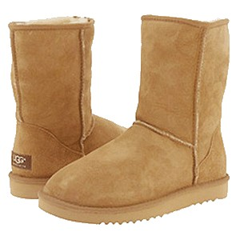
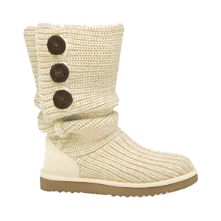
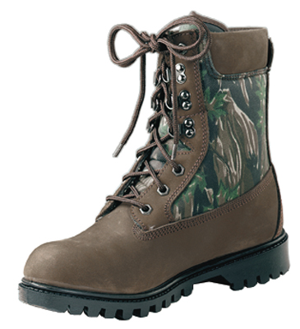
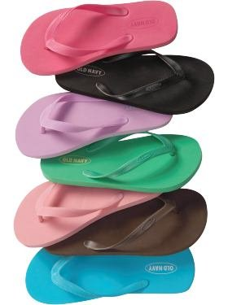
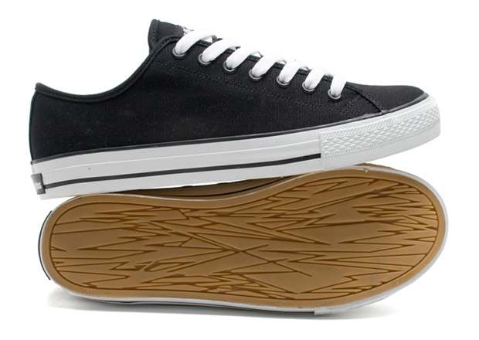
As a class – Shoe Classification
Take off one of your shoes
Looking at the shoe, write down 4 characteristics
Place shoe in a pile at the front of the room
Together we will classify the shoes!

Slide 7
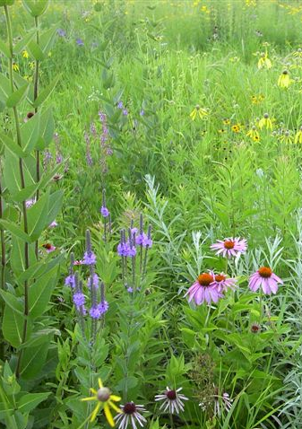
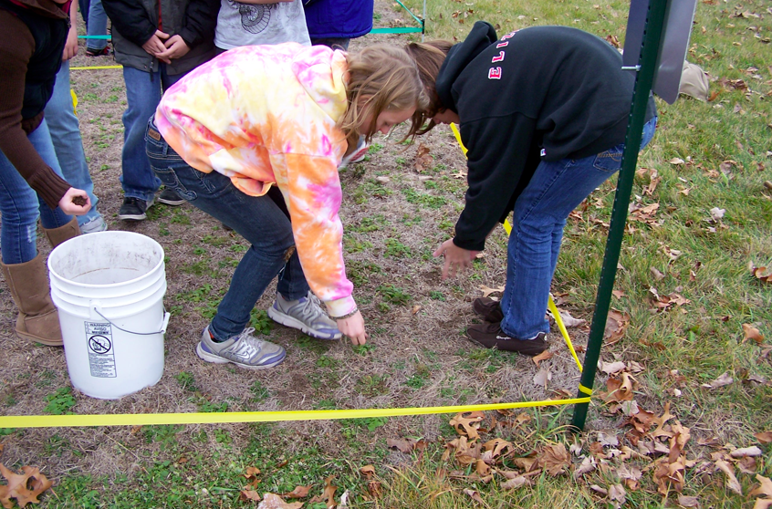
In the lab – Plant Classifications
Make a dichotomous key of the plants that we have seeded out in the Bioenergy Plots at Lawton
Turn that key into a tree
Both the key and tree can be used when we are collecting data on the plots this Spring and in the coming years!

Slide 8
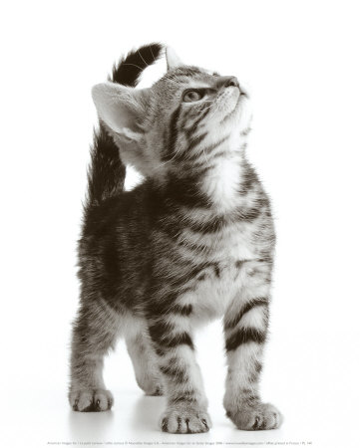
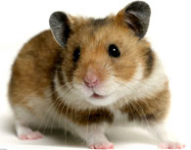
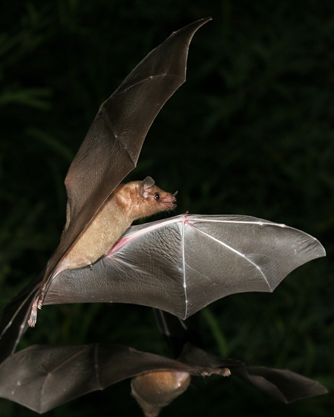
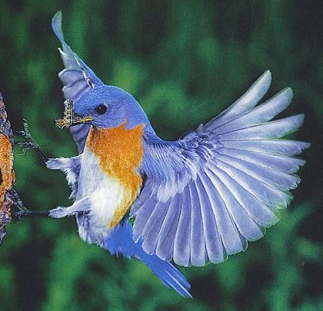
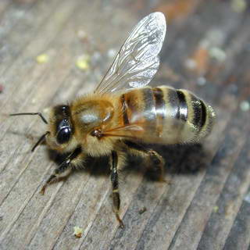
Difficulties with using characteristics to make a tree:
Does your classification scheme capture the true relationship between the plants we used?
Depends on the traits that you chose:
Traits that have a common origin (ex. fur on a cat and fur on a dog) - GOOD
Traits that have “converged” from different origins (ex. wings of a bat and wings of a fly)

Slide 10
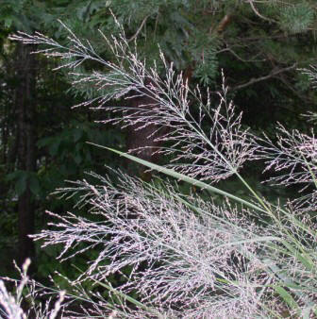
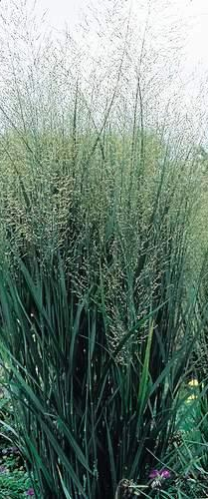
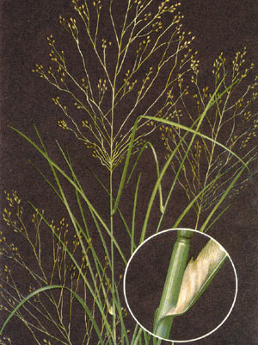
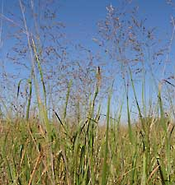
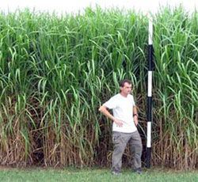
Switchgrass
Notes:
Switchgrass

Slide 11
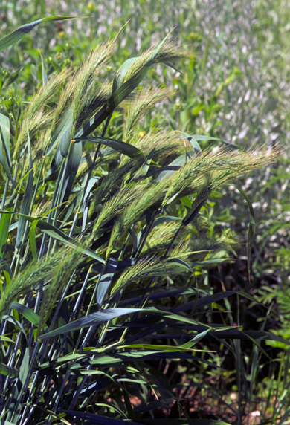
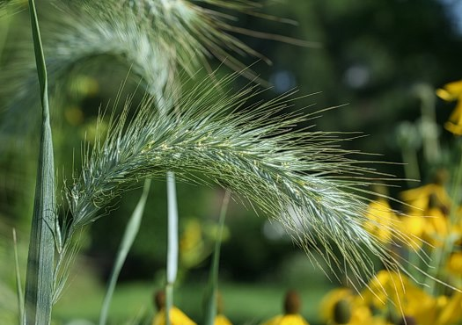
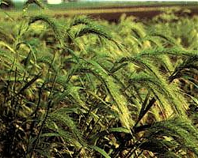
Wild rye
Notes:
Canada wild rye

Slide 12
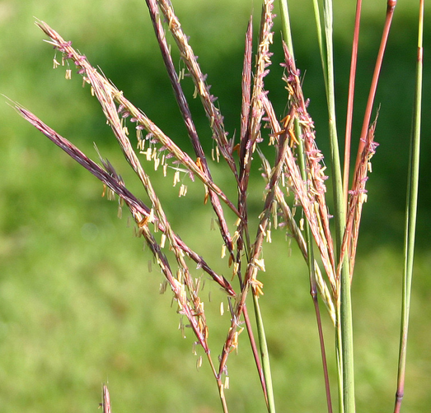
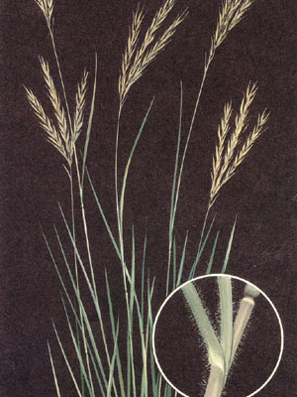
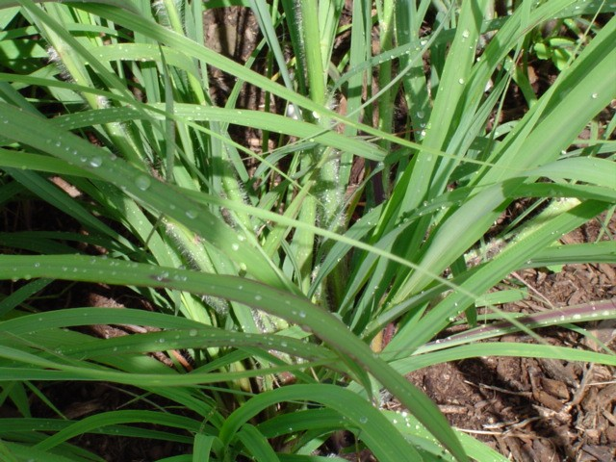
Big bluestem
Notes:
Big bluestem

Slide 13
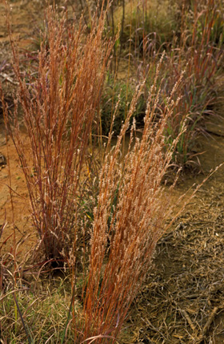
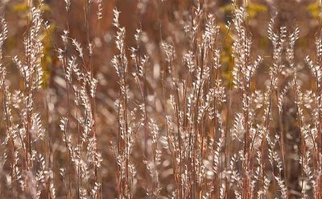
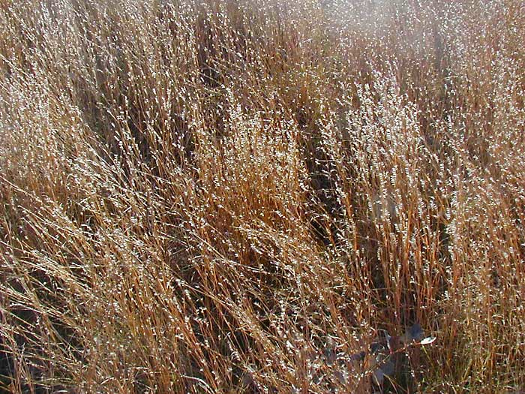
Little bluestem
Notes:
Little bluestem

Slide 14
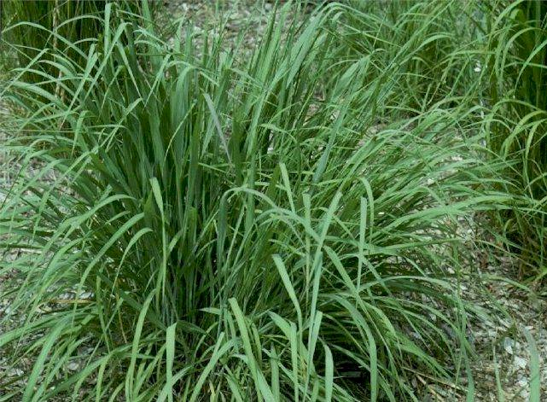
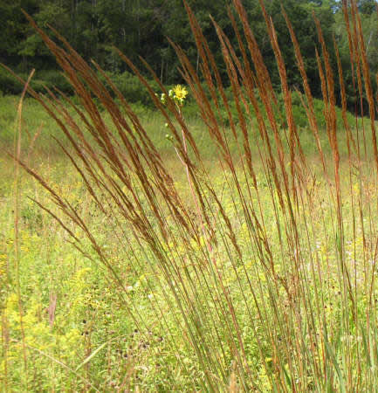
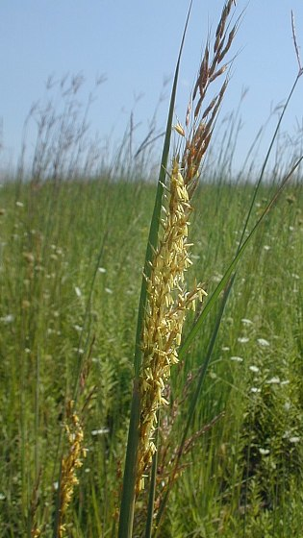
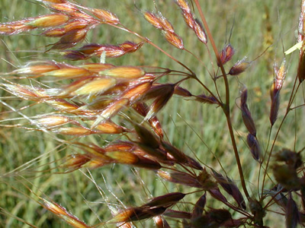
Indian grass
Notes:
Indian grass

Slide 15
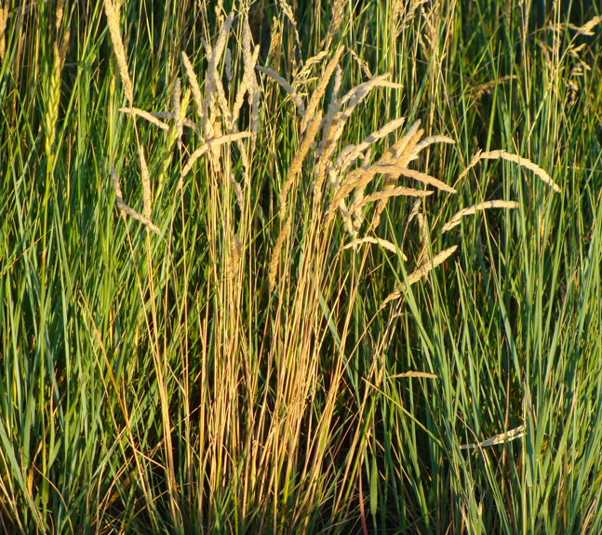
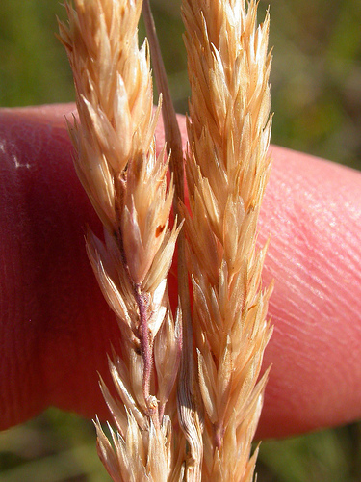
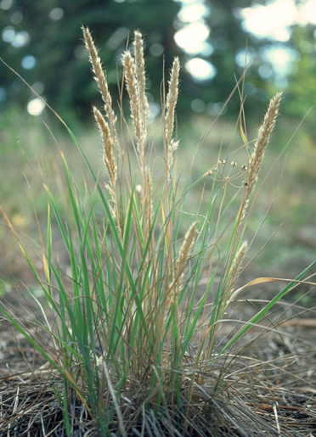
Prairie junegrass
Notes:
Prairie Junegrass

Slide 16
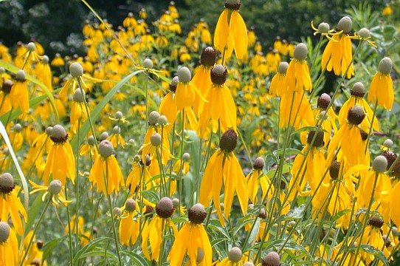
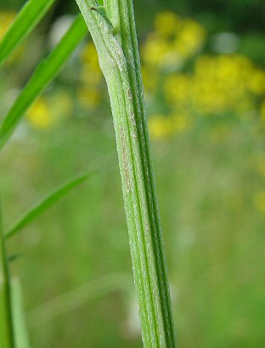
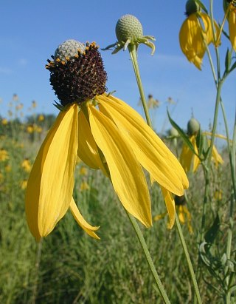
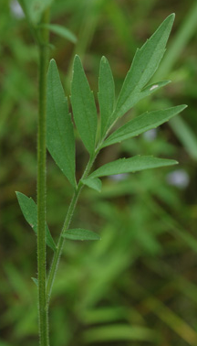
Yellow coneflower
Notes:
Purple coneflower

Slide 17
Black-eyed Susan
Notes:
Black-eyed Susan

Slide 18
Wild bergamot
Notes:
Wild bergamot

Slide 19
Showy tick trefoil
Notes:
Showy tick trefoil

Slide 20
Round-head lespedeza
Notes:
Roundhead lespedeza

Slide 21
White false indigo
Notes:
White false indigo

Slide 22
Canadian anemone
Notes:
Canadian anemone

Slide 23
Butterfly milkweed
Notes:
Butterfly milkweed

Slide 24
Cup plant
Notes:
Cup plant

Slide 25
Rigid goldenrod
Notes:
Rigid goldenrod

Slide 26
Showy goldenrod
Notes:
Showy goldenrod

Slide 27
New England aster
Notes:
New England aster

